Slide 1
got physics?
Playground Project Presentation
By: Jackie Jones, Nitin Chatlani, Leah Catalano, and Blake Newhouse

Slide 2
01
02
03
THEME INTRO
MODEL INTRO
FITNESS OVERVIEW
TABLE OF CONTENTS
04
05
06
RIDE OVERVIEW
SAFETY REVIEW
FINANCIAL ANALYSIS
Take a look at our modern day take on a playground
See it for yourself!
Promoting healthy body practices at a young age.
Making youngsters learn about physics while having fun!
… and stay safe while doing so!
Making sure to keep our playground cost-effective and fun and trendy!
Notes:
blake

Slide 3
NOTE
THESE SLIDES WILL ONLY HAVE SMALL DETAILS BUT THERE WILL BE A HEAVIER EMPHASIS ON THE SAFETY, FINANCES, AND PHYSICS ASPECTS IN THE ACCOMPANYING FOLDER.
Notes:
leah

Slide 4
01
THEME INTRODUCTION
Notes:
nitin

Slide 5
PROBLEM
SOLUTION
Creative Branding
Low short-term cost and high long-term returns on investment
Most children’s playgrounds are not marketed so the costs can never be made up and a profit cannot be turned.
Notes:
jackie

Slide 6
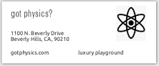


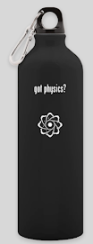
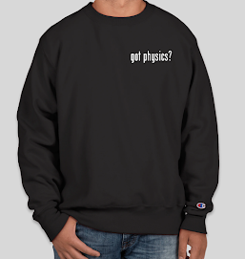
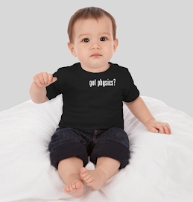
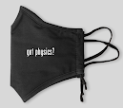
got physics?
THEME
Business cards
Merch (previously endorsed by child-celebrity North West)
Notes:
nitin

Slide 7
330,376,091+
People visit parks each year
Meaning…. Merch sales are gonna be poppin!
Notes:
nitin

Slide 8
02
MODEL INTRODUCTION
Notes:
Blake

Slide 9
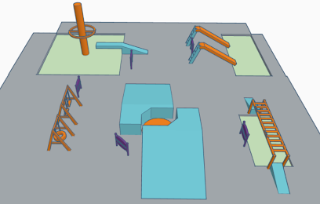
OVERALL MODEL
5 main attractions
Slides (Friction)
Swings (SHM)
Trampolines (Kinematics & Dynamics)
Orbitron Spinners (UCM)
Monkey Bars (Gravity)
Snack Bar
Focusing on healthy eating habits and self-care (North’s Idea)
Merch Bar
Not pictured - merch & snack bars
Notes:
Blake

Slide 10
03
FITNESS OVERVIEW
Notes:
Nitin

Slide 11
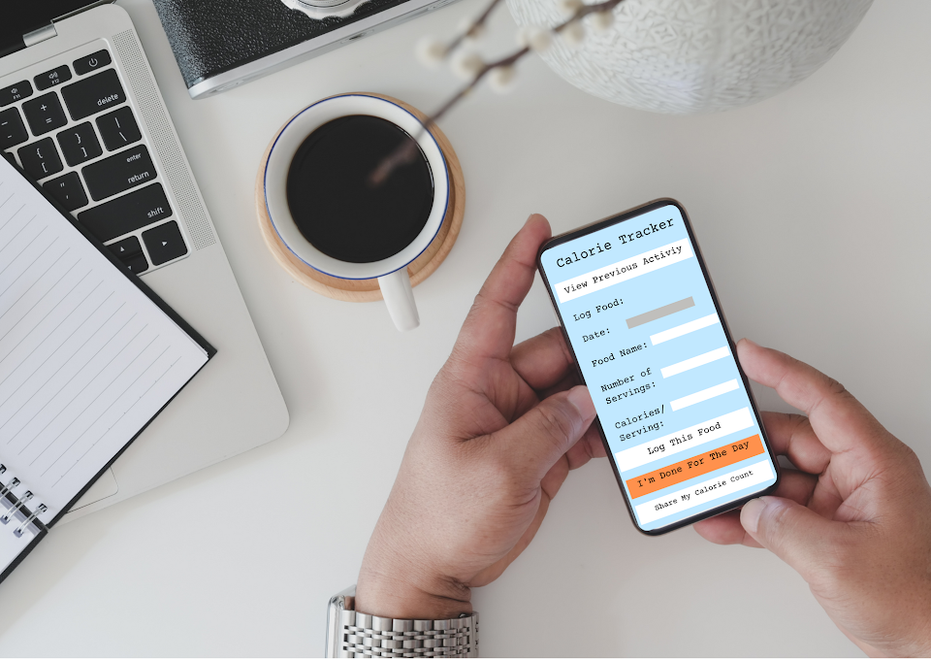

Slide 12

FITNESS OVERVIEW
Kids need to start learning healthy eating habits at a young age
Promoting Body-Positivity
Focus on eating enough not reaching maximum calorie counts
Teach kids about how exercising burns calories that need to be regenerated
Take a look at this beta version of the application!

Slide 13


STRATEGIC FITNESS PARTNERS
fitbit
lululemon
Our app conveniently pairs with fitbits to ensure accurate calorie tracking
Advertises products at the playground (generating income for playground)

Slide 14
04
RIDE OVERVIEW
Notes:
Jackie

Slide 15
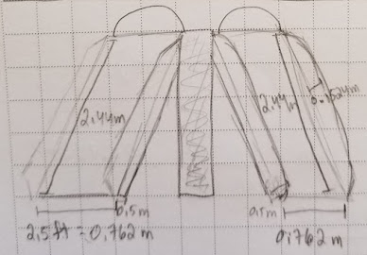
Slide 2
no. 01 -- SLIDES
Slide 1
Made of Steel
Explaining Friction:
The steel slide will make the child go faster because it has a lower coefficient of friction.
(more details in the physics folder)
Made of high-density Polyethylene (HDPE)
Notes:
Jackie
Both slides have the same dimensions the only difference is the shade over the steel one and the material

Slide 16
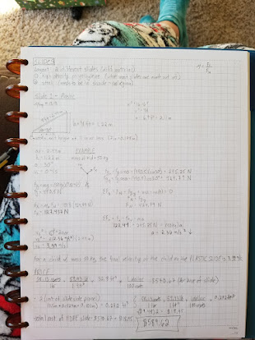
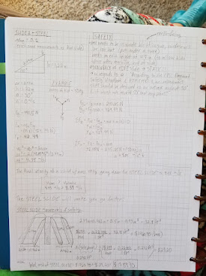
no. 01 -- SLIDES
For a 50 kg child on a STEEL slide w/ the same dimensions as the HDPE slide, the child will have a final velocity of 4.45 m/s. μ~.1
For a 50kg child on a 2.44 m (8ft) HDPE slide at a 30 degree incline, his final velocity will be 3.39 m/s. μ~.3
Notes:
Jackie
Both slides have the same dimensions the only difference is the shade over the steel one and the material

Slide 17
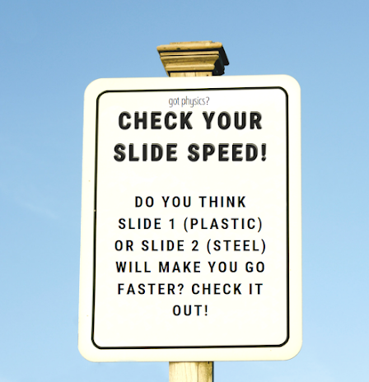
no. 01 -- SLIDES
Slides -- Playground Signs
The steel slide will make the child go faster because it has a LOWER coefficient of friction. The HDPE slide has a coefficient of kinetic friction of 0.3, and the steel slide has a coefficient of kinetic friction of 0.1. Thus, this proves that MATERIAL MATTERS when it comes to building a slide. The signs will concisely show this.
Notes:
Jackie
Both slides have the same dimensions the only difference is the shade over the steel one and the material

Slide 18
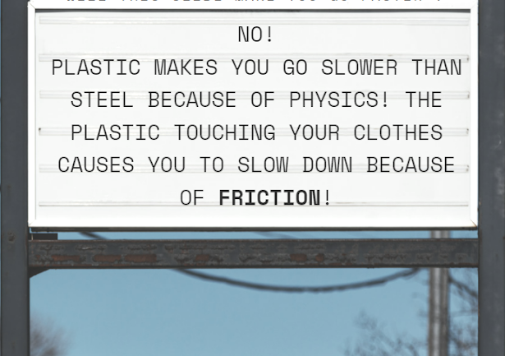
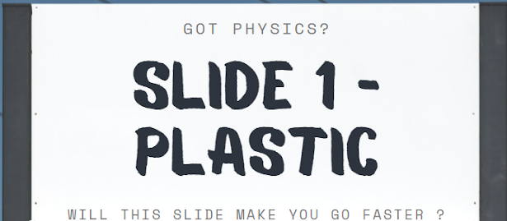
no. 01 -- SLIDES
Sign 1 - Plastic
Notes:
Jackie
Both slides have the same dimensions the only difference is the shade over the steel one and the material

Slide 19
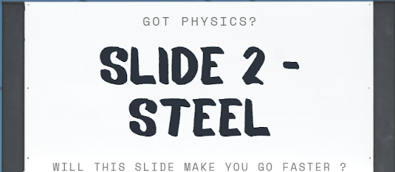
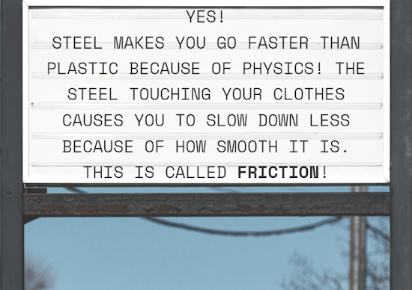
no. 01 -- SLIDES
Sign 2 - Steel
Notes:
Jackie
Both slides have the same dimensions the only difference is the shade over the steel one and the material

Slide 20
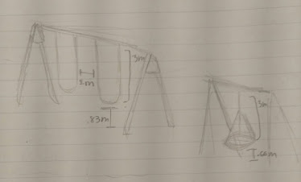
Swing 2
no. 02 -- SWINGS
Swing 1
Tire Swing made of rubber
Explaining Simple Harmonic Motion:
The swings work the same as pendulums. Focus on the period of a pendulum and the factors affecting it.
(more details in the physics folder)
Steel supports, HDPE, Redwood (to repel insects and water), and rubber
Notes:
Leah

Slide 21
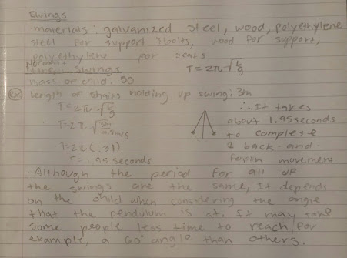
no. 02 -- SWINGS
In-depth Physics for the swings
Since the length of the swings are the same, their periods will also be the same.
The time it takes for kids to get to certain heights/angles, however, will be dependent on the force exerted by the use to swing themself.
Notes:
Leah

Slide 22
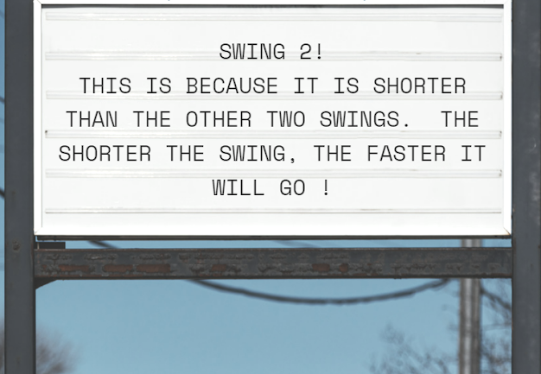
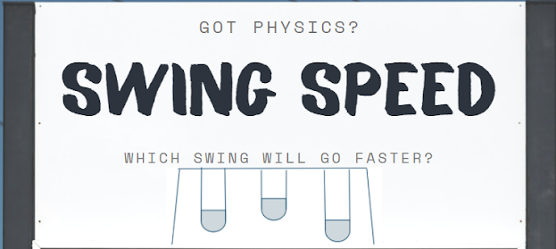
no. 02 -- SWINGS
Sign 2 - Steel
Notes:
Jackie
Both slides have the same dimensions the only difference is the shade over the steel one and the material

Slide 23
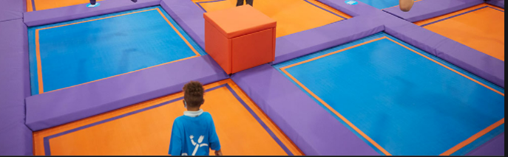
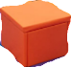
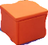
no. 03-- Trampoline
Explaining Energy
The different heights of the pedestals will cause the child to have different amounts of gravitational potential energy. This means that the child jumping will have different velocities when jumping due to the equating of the potential and kinetic energies.
(more details in the physics folder)
Notes:
Leah

Slide 24
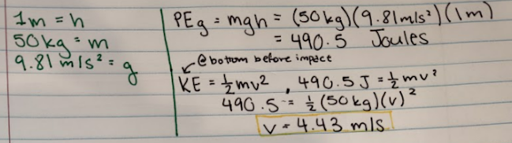
no. 02 -- TRAMPOLINES
In-depth Physics for the TRAMPOLINES
Since there are different pedestal heights, there will be greater amounts of potential gravitational energy which get converted into kinetic energy allowing for us to solve for velocity and conclude that the higher you go the faster you will fall onto the trampoline.
Notes:
Leah

Slide 25
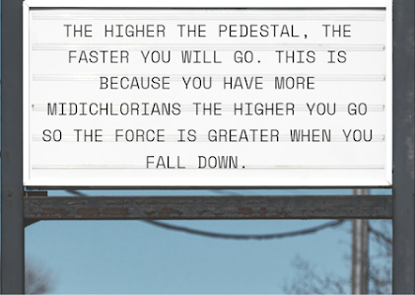
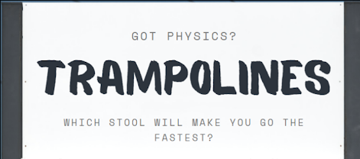
no. 03-- TRAMPOLINES
Notes:
Jackie
Both slides have the same dimensions the only difference is the shade over the steel one and the material

Slide 26
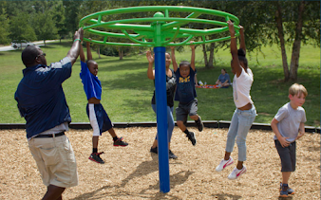
no. 04-- ORBITRON SPINNER
Explaining Angular/Rotational Motion:
The different speed will make the riders spin faster (increasing tangential velocity) which will cause the rider to fly farther away from the center.
(more details in the physics folder)
Notes:
Blake

Slide 27
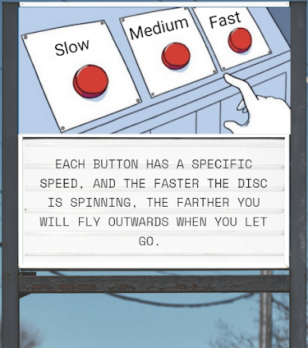
no. 04 -- orbitron spinner
Sign for orbitron spinner
Notes:
Blake

Slide 28
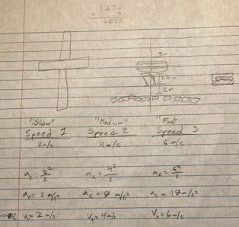
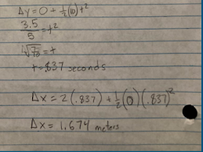
no. 04-- ORBITRON SPINNER
In-depth Physics for the orbitron spinner
The more angular velocity(⍵) that you have, the more linear displacement you will have once you let go of the spinner.
The radius of the spinner is 2 meters long, and is 3.5 meters above the foam pit.
Notes:
Blake

Slide 29
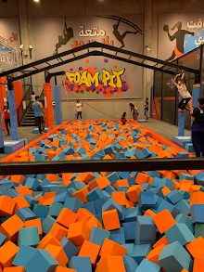
concept explained:
sign:
No. 5 - monkey bars
gravity!!
What do you think will happen when you let go of the bars? Will you levitate, fly, or fall? Sadly, it’s FALL because of GRAVITY!! Here on Earth, you experience gravity every second of your life. Try it out now!!

Slide 30
05
SAFETY REVIEW
Notes:
Nitin

Slide 31
~ SLIDE SAFETY ~
The steel slide needs to be in the shade, or else it could burn the kids bums off.
There needs to be an exit height of at least 0.18m (7 in) so if kids have their legs stuck straight out when going down the slide, there ankles don’t break upon impact with the ground.
“According to the CPSC Playground Safety Handbook and ASTM F1487-11, an embankment slide should be designed to an average angle of 30 degrees and it must not exceed 50 degrees at any point.” → in regards to theta

Slide 32
~ SWING SAFETY ~
Foam pit to break fall
The CSFC recommends that there should be at least 2 ft. away from each other and either 6 ft. surrounding the swingset and/or an equal space twice the arc length of the swings to both the front and back of it.
The distance from the ground for the normal swings is 2.5 ft and the distance between swings is 3 ft.
The surrounding material should be something that can absorb one’s impact if they fall or jump hard.
The chains are coated in HDPE to protect from overheating.

Slide 33
~ TRAMPOLINE SAFETY ~
The trampolines are surrounded by foam pedestals
The trampolines are also incredibly safe due to the strong support of the springs which can have a weight threshold of 400 lbs (more than enough for a child)
There is a limit of one child at a time to make sure kids aren’t stepping on one another as well.

Slide 34
~ ORBITRON SPINNER SAFETY ~
Foam pit underneath
The spinner is 3.5 meters above the foam pit, which makes it so that it will take 0.837 seconds to fall from letting go. Using kinematics, the kids will be launched a maximum of 5.022 meters at the fastest speed. We made a foam pit with a radius of 9 meters, to account for the 2 meter radius of the spinner, 5 meters of launch distance, and 2 meters for safety. The platform used to access the spinner is made out of soft foam, which is padded in the case of a collision. We included a warning on the safety sign to warn against letting go of the spinner close to the platform.

Slide 35
~ MONKEY BARS SAFETY ~
Foam pit under to break fall!
At a reasonable height above foam pit
Foam pit goes deep enough (~2.5m) to ensure kids don’t hurt their bums on the bottom of the floor

Slide 36
06
FINANCIAL OVERVIEW
Notes:
Nitin

Slide 37
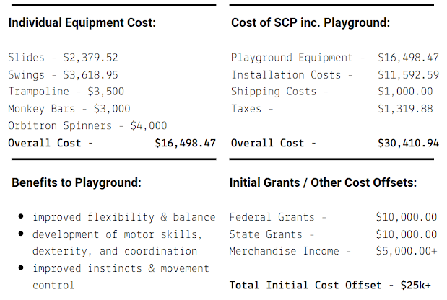
TOTAL COST
FINANCES

Slide 38
THIS PARK SLAYS
The bottom line-

Slide 39
https://www.gametime.com/news/what-is-the-cost-of-commercial-playground-equipment-cost
https://www.playgroundequipment.com/how-much-does-a-playground-slide-cost/
https://www.bciburke.com/our-products/product/orbitron#:~:text=Key%20Features%3A,Approximate%20List%20Price*%3A%20%243%2C691
sources
https://www.gametime.com/news/what-is-the-cost-of-commercial-playground-equipment-cost
https://www.playgroundequipment.com/how-much-does-a-playground-slide-cost/
https://www.gametime.com/news/what-is-the-cost-of-commercial-playground-equipment-cost
https://www.playgroundequipment.com/how-much-does-a-playground-slide-cost/
https://www.playgroundequipment.com/choose-slide-equipment-by-shape-and-material/
https://ers.fpg.unc.edu/sites/ers.fpg.unc.edu/files/playground.pdf
https://thefield.asla.org/2016/09/08/playing-with-topography/
https://www.gametime.com/news/what-is-the-cost-of-commercial-playground-equipment-cost
https://www.playgroundequipment.com/how-much-does-a-playground-slide-cost/
https://www.archiexpo.com/prod/grup-fabregas/product-153538-1782124.html
https://www.homedepot.com/p/Creative-Cedar-Designs-Ultimate-Yellow-Swing-Seat-with-Chain-BP014-Y/300685614
https://homeguide.com/costs/cost-to-stain-a-deck
https://www.cpsc.gov/s3fs-public/325.pdf

Slide 40
final report
+
canva report

